Slide 1
Power BI Project: Columbia Asia Hospital
Naganathan Arjun Manicka Sridhar
10-01-2025

Slide 2
Agenda
01.
04.
02.
03.
Problem Statement
Subjective Analysis
Data Description
05.
Dashboard
Key Metrics and Visualizations
06.
Conclusion

Slide 3

01.
Problem Statement

Slide 4
Problem Statement
Columbia Asia Hospital is seeking a data-driven approach to enhance its operations and decision-making processes.
Primary objectives are to assess the hospital's revenue generation, identify departments requiring new hires, and develop effective strategies for offering patient discounts.
Analyse relevant data, uncover key insights, and provide actionable recommendations.
The goal is to support the hospital in optimizing its financial performance, staffing decisions, and patient engagement.

Slide 5
02.
Data Description

Slide 6
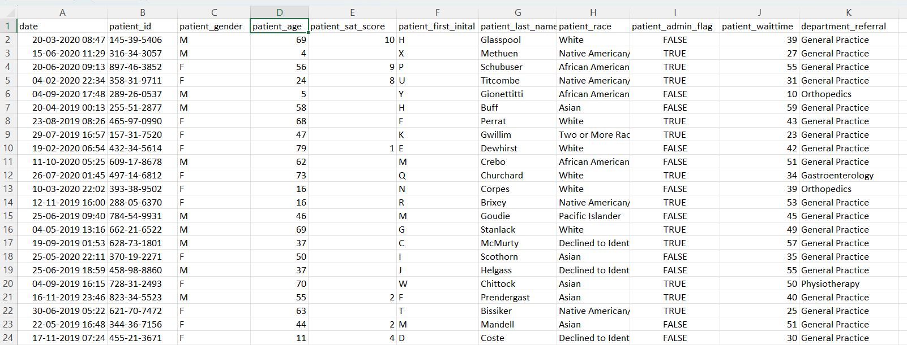
Data Description

Slide 7
Data Description
The image above displays details about Columbia Asia Hospital data, including:
Date: This column contains date and time information without specifying AM or PM. The format is DD-MM-YYYY HH:MM.
Patient ID: Each patient is assigned a unique identifier, which seems to be in the format 124-62-3289.
Patient Gender: This column records the gender of the patient, denoted by 'M' for male and 'F' for female.
Patient Age: The age of the patients is listed in years.
Patient Sat Score: It seems to represent a satisfaction score given by or for the patient. However, the scores are single-digit, and it's not clear what the scale is.
Patient First Initial: This column contains the first initial of the patient's first name.
Patient Last Name: The surname of the patient is listed in this column.

Slide 8
Data Description
Patient Race: The racial or ethnic background of the patient is recorded here, with categories such as 'White', 'African American', 'Asian', 'Native American/Alaska Native', and 'Two or More Races'.
Patient Admin Flag: This column contains boolean values ('TRUE' or 'FALSE') which might indicate whether the patient was admitted or some other administrative flag.
Patient Wait Time: Appears to indicate the time the patient waited, possibly in minutes, before being seen or processed.
Department Referral: This column lists the department to which the patient was referred, with entries such as 'General Practice', 'Orthopedics', 'Gastroenterology', or 'None' indicating no referral.
Doctor Name: Identifies the doctor who attended each patient.
Appointment Fees: The cost charged for a doctor's consultation.
Total Bill: The overall amount billed to the patient, including all services and charges.

Slide 9
Methodology
Data Extraction and Preparation: Extract data from databases or files while ensuring accuracy, removing duplicates, handling missing values, and maintaining completeness.
Data Transformation and Cleaning: Clean and transform data using SQL or Power Query, standardize formats, create calculated fields, and integrate datasets for consistency.
Data Modeling and Relationships: Create a data model by establishing table relationships using tools like Power BI or Tableau for accurate and efficient visualizations.
Dashboard Design and Visualization: Design visuals tailored to user needs, using charts, KPIs, filters, interactivity, slicers, and drill-throughs effectively.
Testing and Optimization: Test dashboards for performance, functionality, and accuracy. Optimize visuals and queries for seamless, cross-platform usability.
Deployment and Maintenance: Publish the dashboard online or locally, schedule refreshes, monitor performance, and integrate feedback for reliability.

Slide 10
03.
Key Metrics and Visualizations

Slide 11
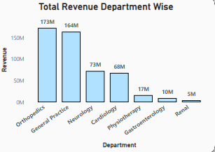
Department Wise Revenue
Orthopedics leads in terms of department wise revenue with $173 Million, followed by General Practice at $164 Million.
Renal is the department with the lowest revenue, generating $5 Million.
This chart offers insights into departmental revenue, aiding in recommending strategies to boost the lowest-performing department.

Slide 12
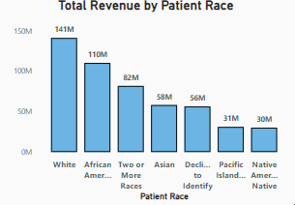
Total Revenue by Patient Race
This visual depicts the distribution of hospital revenue in terms of patient’s race.
The patients with White race have contributed to $141 Million, that is 27.7% of the total generated revenue, followed by African race, generating a revenue of $110 Million (21.6% of the total revenue).
The Native American race has the least contribution amongst the races with $30 Million.

Slide 13
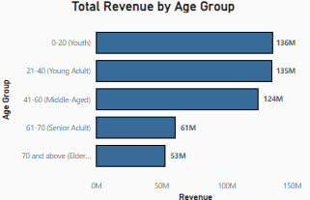
Total Revenue by Age Group
The patients from age 0-20 under the Youth category contributed $136 Million which is 26.7% of the total revenue.
The Elderly age group ( > 70 years) were the least contributors with $53 Million which is 10.4% of the total revenue.

Slide 14
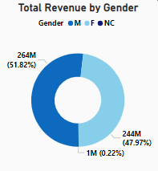
Total Revenue by Gender
Male patients have contributed the highest combined revenue of $264 Million which is 51.82% of the total revenue.
Female patients have contributed a combined revenue of $244 Million which is 47.97% of the total revenue, slightly lesser compared to male patients contribution.
Non Categorized Gender have contributed the least revenue of $1 Million which is 0.02% of the total revenue.

Slide 15
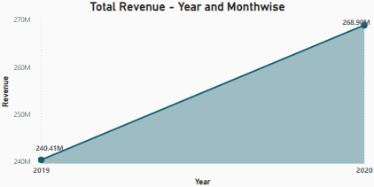
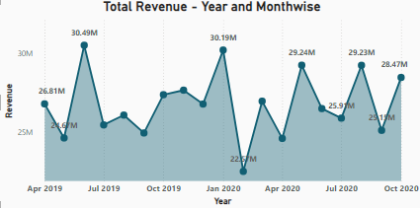
Total Revenue by Years and Months
We can observe the hospital’s revenue across years and months ranging from $22.5 – 30.5 Million
The revenues were highest during the June 2019 at $30.49 Million.
The month with the least revenue was February 2020 which had a revenue of $22.57 Million.

Slide 16
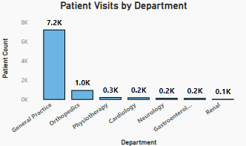
Department wise Patient Visits
The General Practice department witnessed a greater number of patient visits of close to 7,200 patients.
The Renal department had the least number of patients with an approximate count of 100.
This visual helps us to get insights on ways to improvise the frequency of patient visits where there is least patient count.

Slide 17

$509 Mi.
9,216
35.26
Total Revenue Generated
Total Number of Visitors
Average Waiting Time of Patients in minutes

Slide 18
General Practice
Dr. Smith
5 / 10
Most Visited Department
Most Visited Doctor
Average Satisfaction Score of Patients

Slide 19
99%
Profitability achieved by the hospital in terms of the generated Revenue

Slide 20
04.
Subjective Analysis

Slide 21
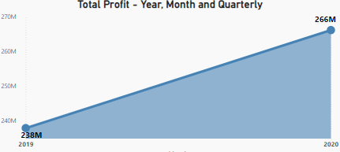
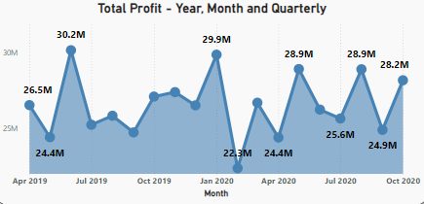
Total Profit
There is an increase in profit from $ 238 Million in 2019 to $266 Million in 2020 which is a 12% increase.
The revenue has been highest during June 2019 at $30.2 Million.
The least revenue was generated during February 2020 which is $23.2 Million.
These visuals help us to analyse the trends that led to the increase or decrease of the profits over a period of time.

Slide 22
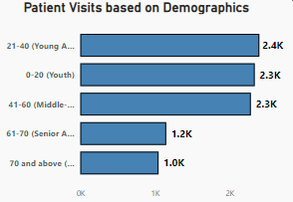
Patient Visits by Demographics - Age Group
The hospital was visited by more patients in the age group of 21-40 (Young Adults) which was approximately 2,400.
The hospital was least visited by patients in the age group of >70 (Elderly) which was approximately 1,000.
This visual helps us to get insights on the factors related to the patient visits based on the age group distribution.

Slide 23
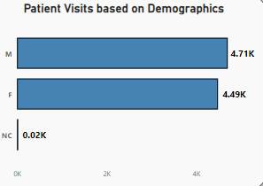
Patient Visits by Demographics - Gender
The hospital was mostly visited by 4,710 Male and 4,500 female patients.
The hospital was least visited by patients in the NC gender which was approximately 20.
This visual helps us to get insights on the factors related to the patient visits based on the gender distribution.

Slide 24
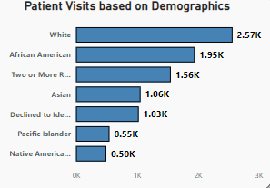
Patient Visits by Demographics - Race
The hospital was visited by more patients belonging to the White race which was approximately 2,570.
The hospital was least visited by the patients of Native American race which was approximately 500.
This visual helps us to get insights on the factors related to the patient visits based on the race.

Slide 25
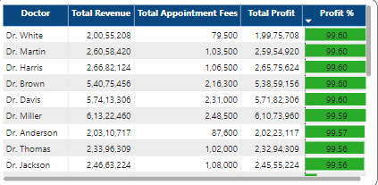
Profitability of Doctors
The hospital has shown an average profitability of 98.95% with more than 50% of doctors with a profitability >99%.
Total Profit = Total Revenue – Total Appointment Fees
Profit % = ( Total Profit / Total Revenue ) * 100
Dr. White has contributed the highest profit % at 99.6%.

Slide 26
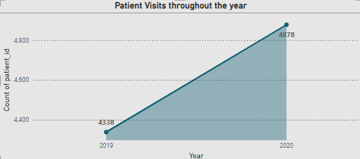
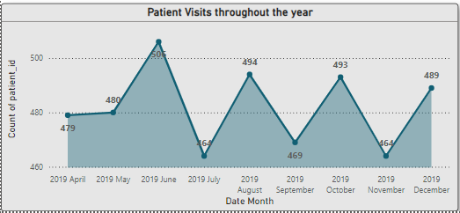
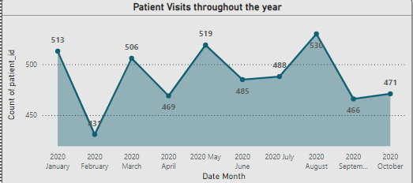
Patient Visit Trends
There is a 7% increase in the number of patients from 4338 in 2019 to 4878 in 2020.
Across the months, we can infer that 2020 August has the highest number of patient visits at 530.
February 2020 witnessed the least patient count of 431.

Slide 27
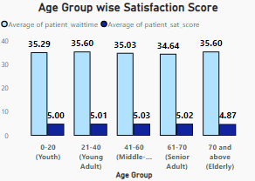
Satisfaction Score and Wait Time by Age Group
The waiting times are almost same across the age groups ranging from 34.64 – 35.60 minutes.
The satisfaction score is also consistent across the age groups ranging between 4.87 and 5.03.
Age Group with highest wait time – Young Adults and Elderly with 35.6 minutes
Age Group with highest satisfaction score – Middle Aged Adults with a score of 5.03

Slide 28
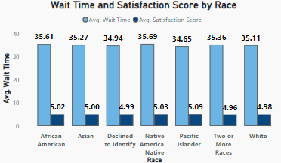
Wait Time and Satisfaction Score by Race
The waiting times are almost same across the races ranging from 34.65 – 35.69 minutes.
The satisfaction score is also consistent across the age groups ranging between 4.96 and 5.09.
Race with highest wait time – Native American with 35.6 minutes.
Race with highest satisfaction score – Pacific Islander with a score of 5.09.

Slide 29
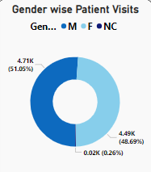
Gender wise Patient Visits
The hospital was mostly visited by 4,710 Male and 4,500 female patients.
The hospital was least visited by patients in the NC gender which was approximately 20.
This visual helps us to get insights on the factors related to the patient visits based on the gender distribution.

Slide 30
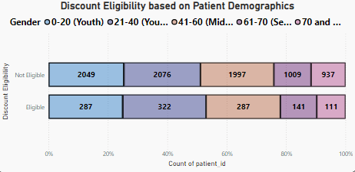
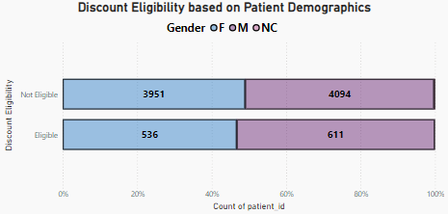
Discount Eligibility proportion by Age Group and Gender
The visuals indicate that 322 young adults aged 21-40 qualify for bill discounts.
Additionally, more female patients (611) are eligible for discounts compared to male patients (536).
These visuals aid in analyzing patient spending and offering discounts based on total bills and satisfaction scores.
Assumption: Patients qualify for discounts with total bills exceeding 20,000 and a satisfaction score of 6 or higher.

Slide 31
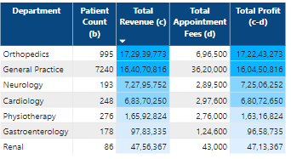
New Hires - Suggestions
With the Orthopedics department generating the highest revenue at $ 173 Million and $0.6 Million in Appointment fees, it can be a good choice to hire new doctors for this department.
The General Practice department is the next preferred choice for new hires, handling 7,240 patients, generating $164 million in revenue, and approximately $3.6 million from appointment fees.

Slide 32
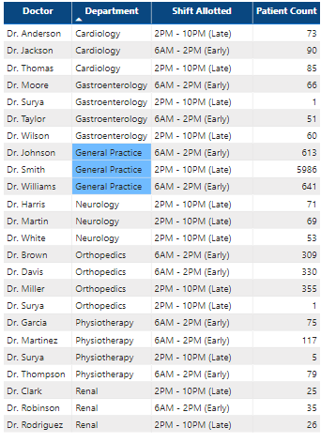
Shift Timings - Suggestions
The General Practice department has the highest patient count and there are only 3 doctors present in the department.
To handle the patient load, doctors are allocated to either of 2 shifts (Early / Late) which can be helpful to distribute the patient load.

Slide 33
05.
Dashboard

Slide 34
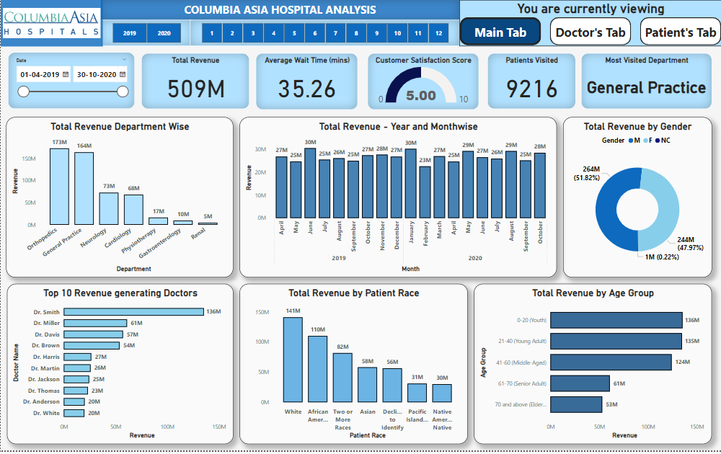
Main Tab

Slide 35
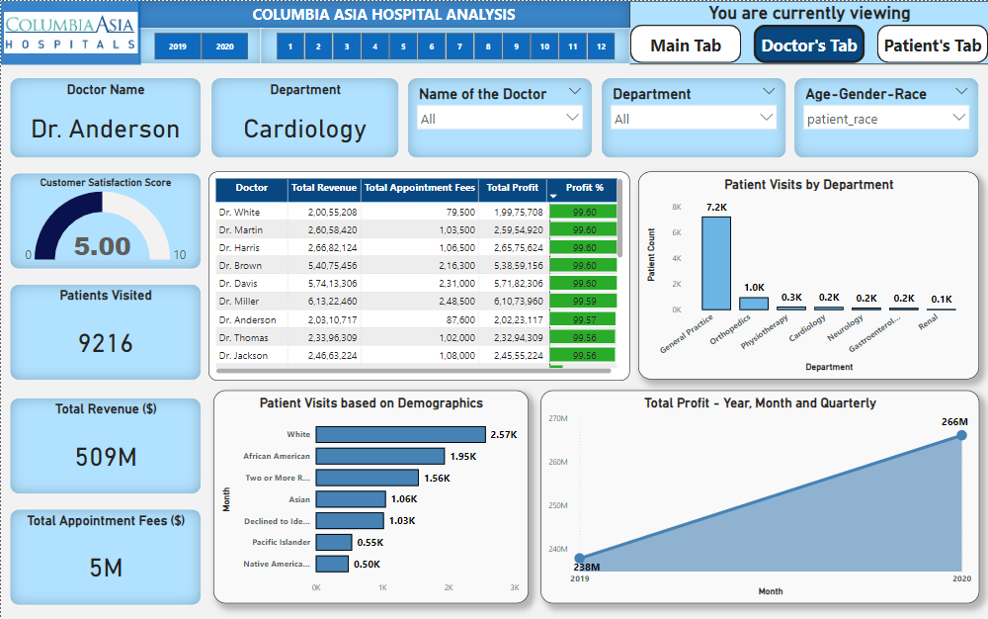
Doctor’s Tab

Slide 36
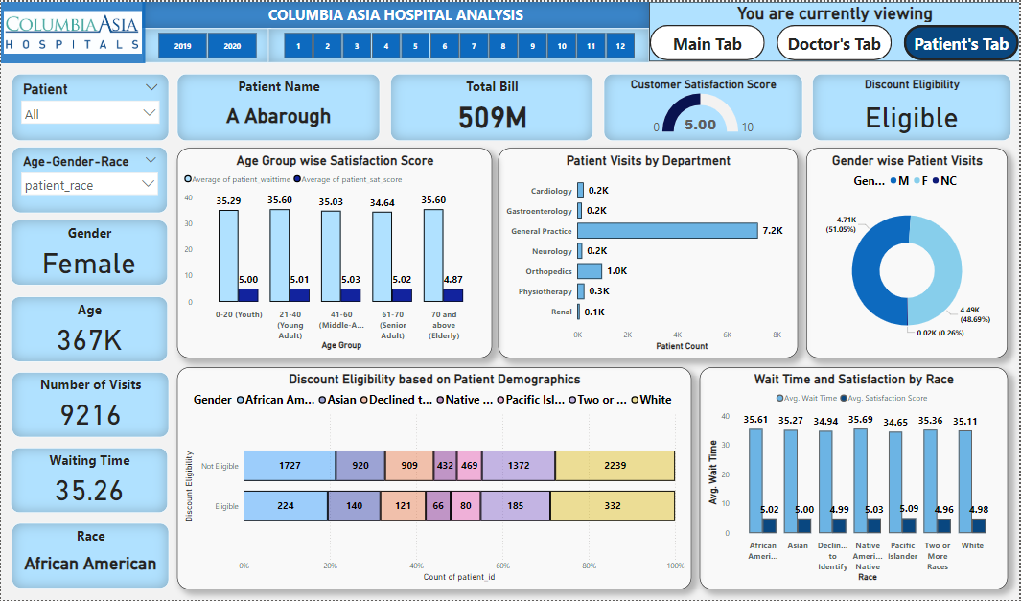
Patient’s Tab

Slide 37
06.
Conclusion

Slide 38
Conclusion
The Orthopedics department leads in revenue with $173M, followed by General Practice at $164M. Renal generates the least revenue of $5M, highlighting areas for improvement.
White patients contribute 27.7% of total revenue, while Native American patients contribute the least at $30M.
Young adults aged 21-40 account for the highest patient visits, while the elderly group contributes the least revenue. Male patients contribute 51.82% of revenue, slightly more than females.
Revenue trends show a 12% increase from $238M in 2019 to $266M in 2020, with June 2019 having the highest monthly revenue.
General Practice sees the most patient visits but has only three doctors, requiring better resource allocation.
Insights from patient demographics, spending patterns, and satisfaction scores aid in strategic decisions to optimize revenue, patient visits, and staffing.

